Slide 1

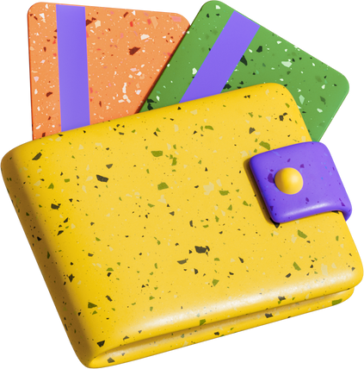

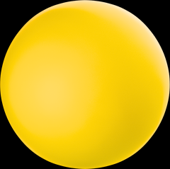
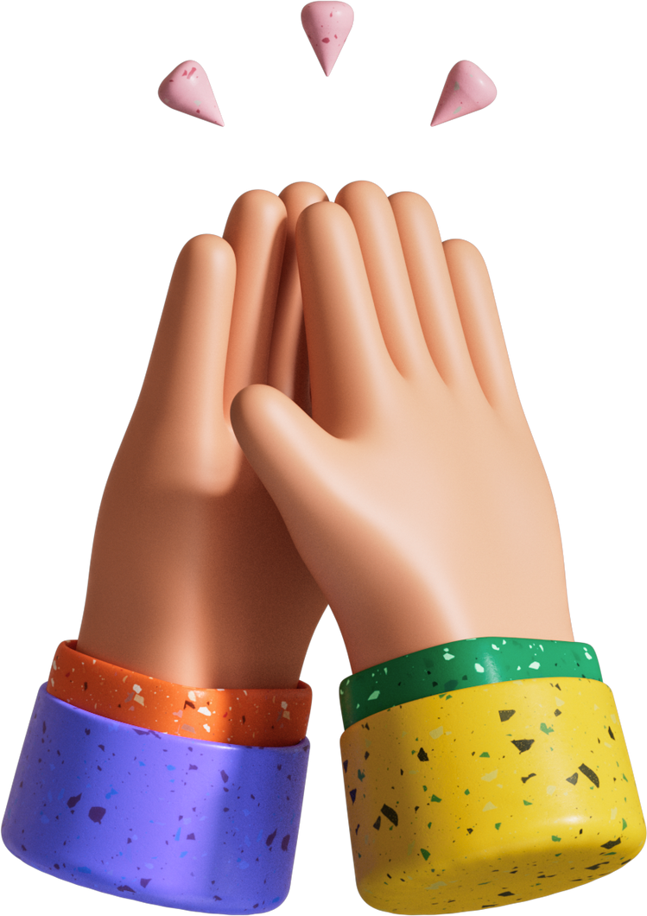
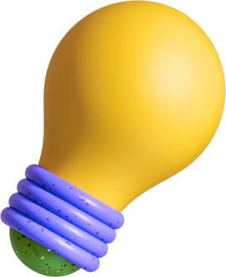

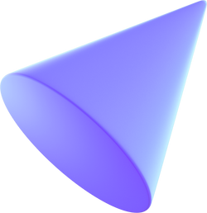
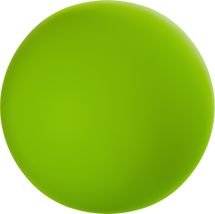
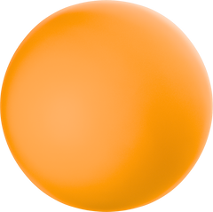
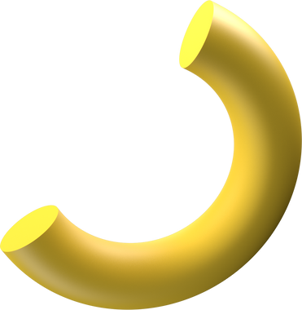
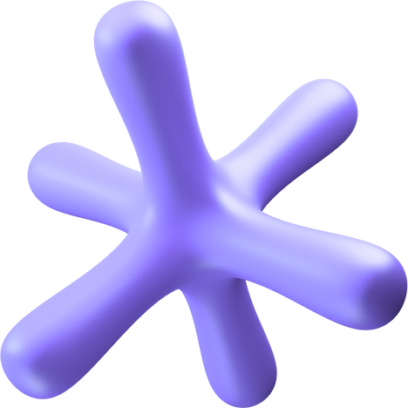
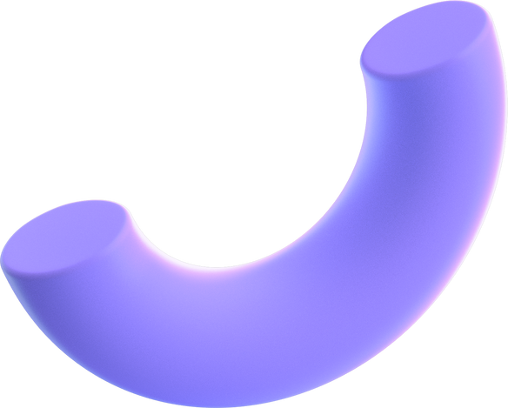
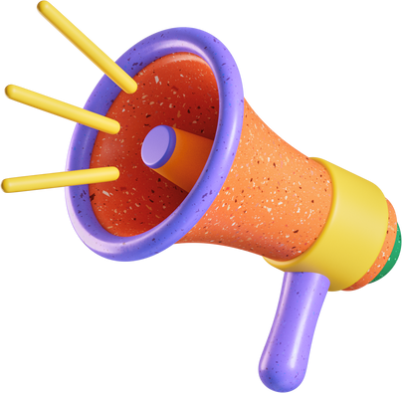
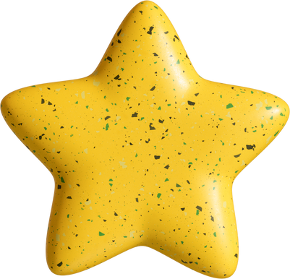
3D/MAYA
PRESENTATION
BC No. BC00000163
By - Prashant Chaudhary

Slide 2


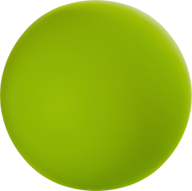

Agenda
1 | Introduction
2 | FANTASY WEAPON / GAME ASSET (GRENADE)
3 | MODERN WEAPON (SNIPER)
4 | ENVIRONMENT DESIGN (HOUSE)
5 | PRODUCT DESIGN (WATER HYDRANT)
8 | THANKYOU SLIDE

Slide 3
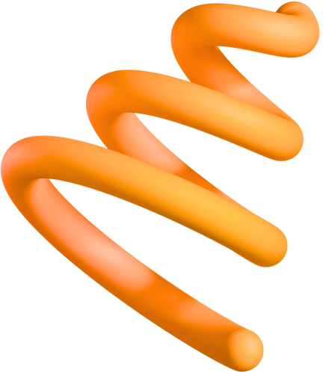
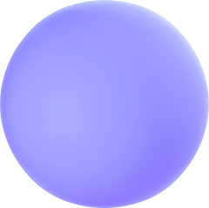


Introduction

Slide 4
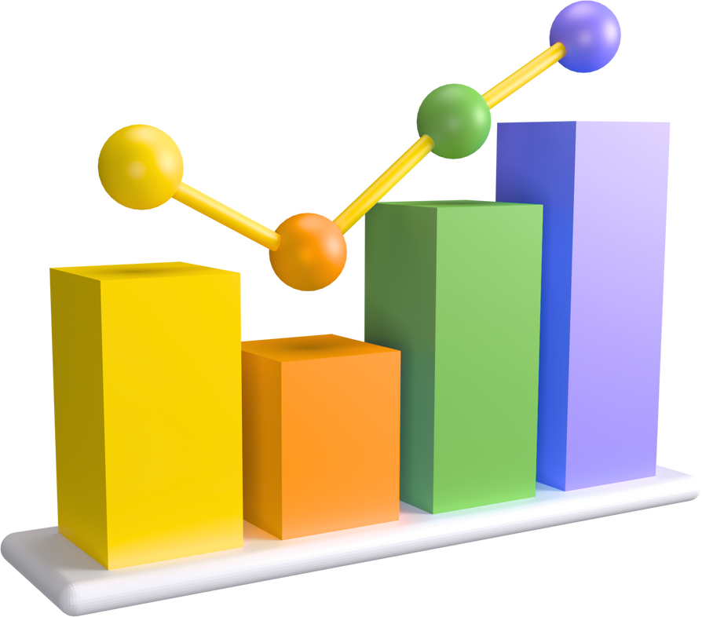
Introduction
Autodesk Maya is a professional-grade software used for creating 3D models, animations, visual effects, and simulations. It's a powerful tool used across various industries, including film, television, video games, and visual effects, and is a core part of the 3D content creation pipeline. Maya allows users to create a wide range of 3D assets, including characters, environments, and objects, and provides tools for rigging, animation, and FX

Slide 5
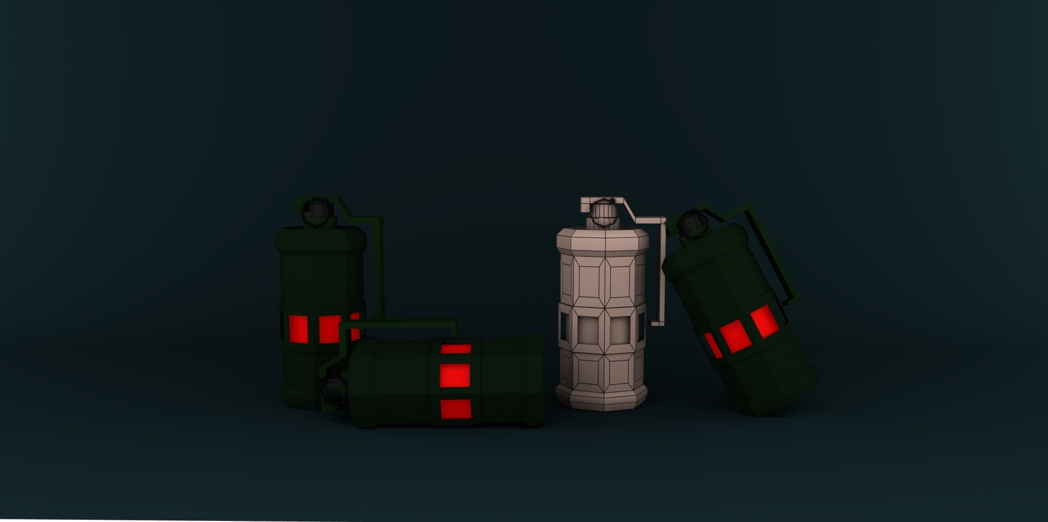
FANTASY WEAPON / GAME ASSET (GRENADE)

Slide 6
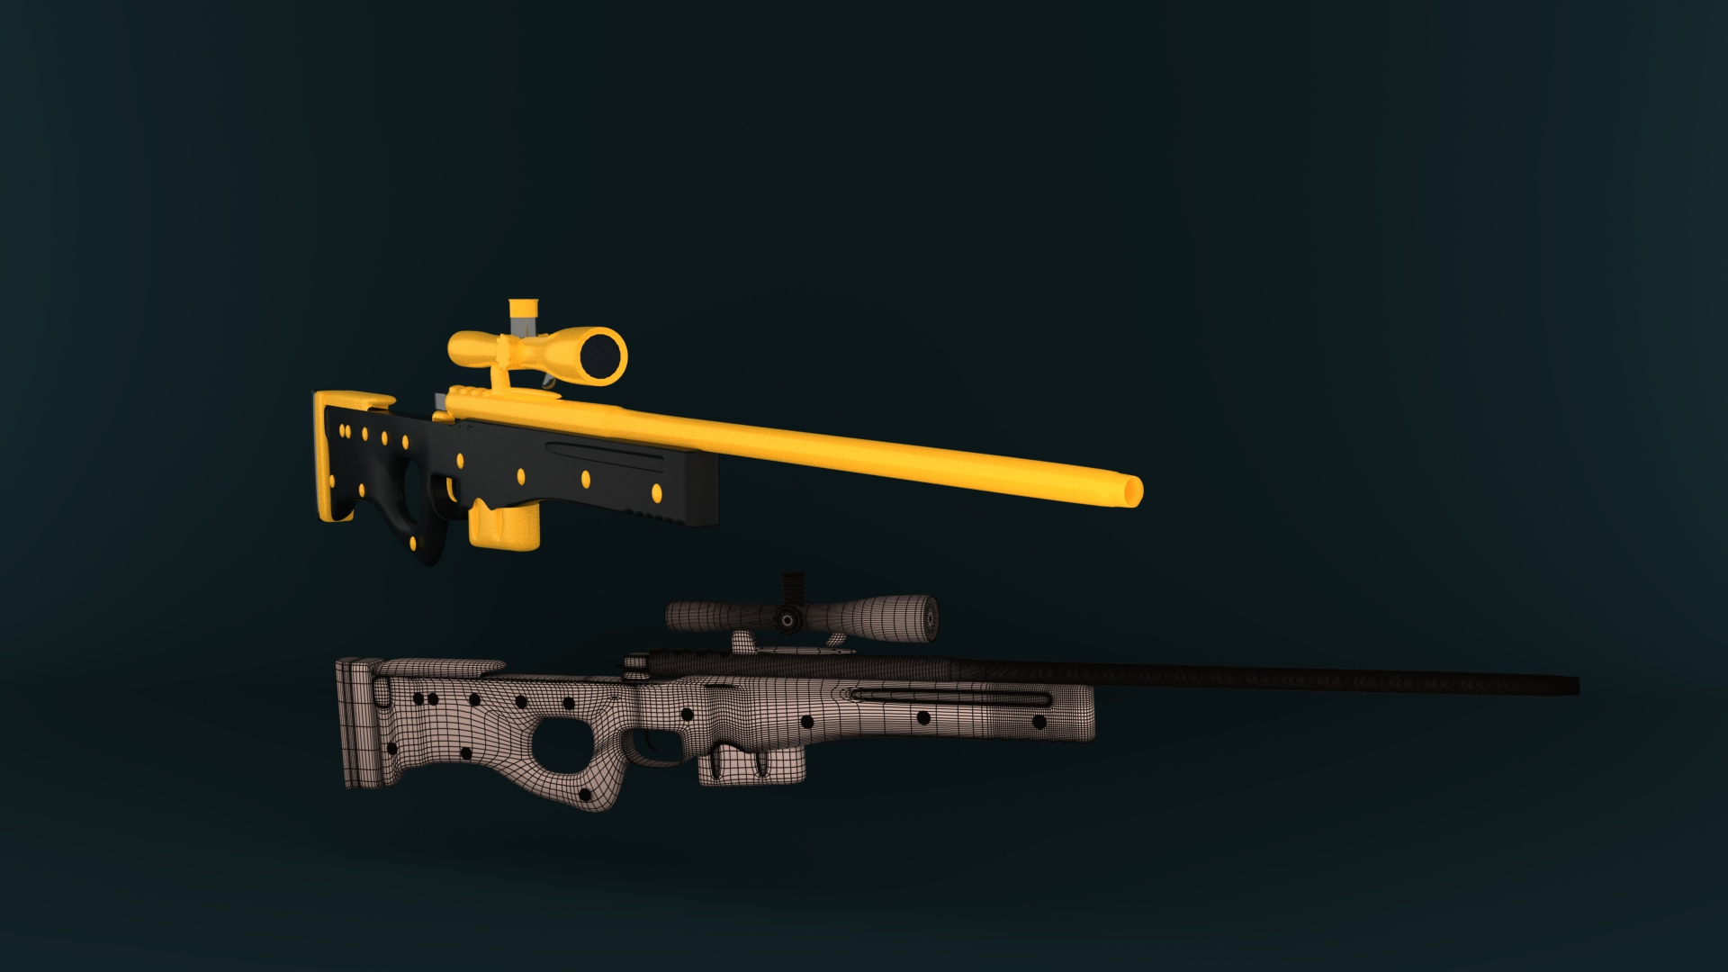
MODERN WEAPON (SNIPER)

Slide 7
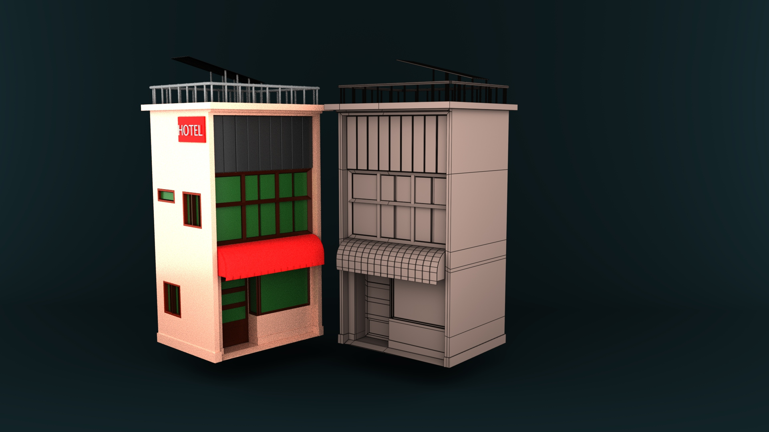
ENVIRONMENT DESIGN (HOUSE)

Slide 8
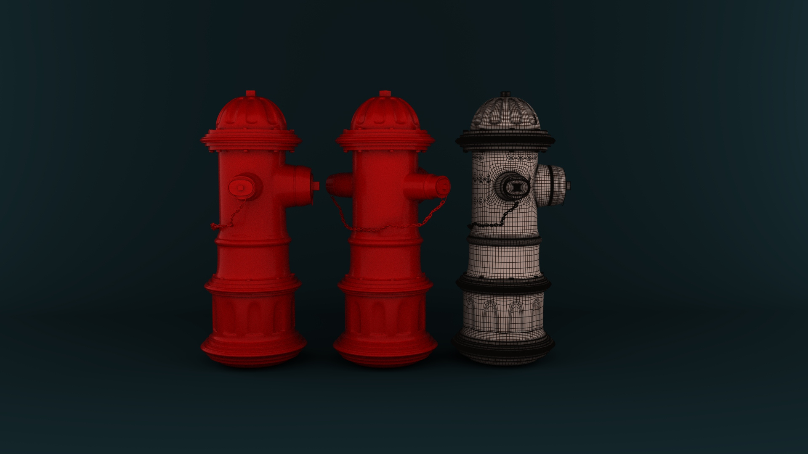
PRODUCT DESIGN (FIRE HYDRANT)

Slide 9
THANKYOU!

